Slide 1

English Year 1
I can sequence sentences to form a story
I can make predictions about what is going to happen
I can join two sentences using and
I can form lower case letters in the correct direction, starting and finishing in the right place
I can draw inferences from the text or pictures
I can put words together to make a sentence
I can say what I like or don’t like about a text
I can sit at a table holding a pencil correctly
Structure
I can use an exclamation mark
I can make links from books to my own experiences
Handwriting
I can use a question mark
I can say a sentence out loud before writing it
I can retell some stories using narrative language
I can use a capital letter to start a sentence
I can find the phonemes in words I know
I can sequence sentences in order to recount an event or experience
I can talk about characters in familiar stories
I can use a full stop to end a sentence
I can use syllables to divide words for spelling
I can recite some poems and rhymes by heart
I can re-read what I have written to check it makes sense
I can use capital letters for names
I can use what I know about tricky phonemes to help me spell words
I can check that my reading makes sense and make corrections when it doesn’t
I can put spaces between words
I know that some words can have a prefix added to change the meaning
I can name all the letters of the alphabet in order
I can use a capital I
Reading
Composition
Punctuation
Spelling

Slide 2
I can draw inferences from illustrations, events, characters, actions and speech
I have begun to use complex sentences with subordinate clauses
English Year 2
I can write with a controlled and neat joined handwriting style
I can ask and answer questions, and make predictions
I can use expanded noun phrases
I can use the diagonal and horizontal strokes needed to join letters
I can use the progressive form of verbs (I am going) in the present and past tenses
I can recite some poems by heart, with expression
I can use present and past tenses accurately
I can form lower case letters correctly sized and orientated, and upper case letters also
I can find repeated language in stories and poems
Structure
I can read for meaning and reread when it does not make sense
I use finger spaces
I can evaluate my writing independently, with friends and with an adult
I use capital letters for the names of places, people, days of the week and the personal pronoun I
Handwriting
I can retell familiar and traditional stories
I can proof read my work and make corrections
I can use my knowledge of phonics to spell
I can use what I have learned before to help me understand texts
I use question marks and exclamation marks correctly
I can plan, discuss and record my ideas
I can identify phonemes in unfamiliar words and use syllables to divide words
I can discus the sequence of events
I can write for different purposes including real events
I use commas to separate words in a list
I can spell some longer words with suffixes ment, ful, less and ly
I can talk about and give an opinion on a range of texts
I can use apostrophes to show where letters are missing and to show possession
I can write stories about personal experiences, both real and imagined
I can spell some common homophones
Reading
Composition
Punctuation
Spelling

Slide 3

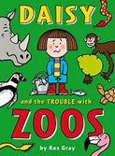




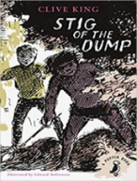

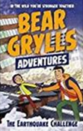
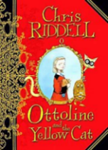
I read a range of fiction, poetry, plays and non-fiction texts and learn new words. I understand how to choose books from our fiction library.
English Progression Map Year 3
I can use conjunctions, adverbs & prepositions.
Painting pictures with words. (Description) Writing to others. (Letters and postcards) Caring for a pet. (Fact file) Discovering the World. (Guide to the Pyramids) | Writing to perform. (Playscripts) The power of storytelling. (Linked to author visit/WBD) Playing with poetry. (Shape poems) Exploring emotions. (Diary writing) | Exploring characters. (Description) What makes instructions easy to follow? Firing our imaginations. (Poetry) Where would you like to live? (Report writing)
I can read aloud independently but can also take turns and listen to others.
I am starting to use paragraphs.
I can use different tenses consistently in my writing (including past tense with has/ have).
I understand that fiction and non-fiction texts can have different layouts.
Structure
I am enjoying and talking about different types of fiction and nonfiction books.
I can discuss and record ideas to help plan my writing.
I can explain what has happened so far and try to predict what will happen next.
I can compose sentences (out loud first). I am beginning to use a wider range of structures including subordinate clauses.
I can infer a character’s feelings , thoughts and motives from their actions.
I can form letters correctly and am practising my joined style.
I can write a narrative with a clear structure and thinking about setting, characters & plot.
I am learning to use a dictionary to check the meaning of unfamiliar words.
I understand which letters should be left unjoined.
I take care to spell the words from our non-negotiable list carefully.
I can write non narrative using headings and sub-headings.
Handwriting
I can identify the main point of a text and use non- fiction texts to retrieve information.
I can spell words correctly from my Year 3 lists.
I can suggest improvements to my own writing and that of others.
I can use basic punctuation in my writing.
I can spell some words from the Y3/4 spelling list.
I can prepare poems and plays to read aloud and to perform, using my voice and actions.
I am learning to proof-read to check for errors in spelling & punctuation
I am learning to use the first two or three letters of a word to check its spelling in a dictionary.
I can use inverted commas to punctuate direct speech.
Reading
Composition
Punctuation
Spelling

Slide 4

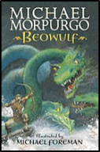
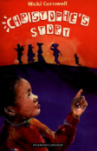
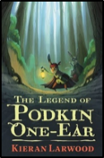
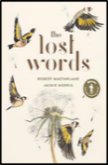


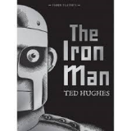
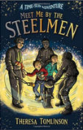
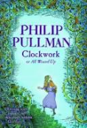
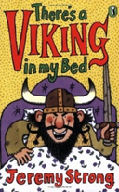


I enjoy a range of books from a range of authors. I am learning how to select books for specific purposes, using the Dewey system in our library.
English Progression Map Year 4
I can identify features of different types of texts and identify simple themes within them.
I can discuss and record ideas to help plan my writing.
Year 4
Sep - Dec | Jan - Apr | May - July
Writing to others. (Letter to my teacher) Real recounts Exploring our language. (Lost Words poetry) Exploring emotions. (Beowulf’s diary) | People who have changed the World. (Biography) We are Scientists. (Recording scientific findings) The power of storytelling. (Linked to author visit/WBD) Persuasion: Battle cry | People who have changed the World. (Shackleton’s scrapbook) Firing our imaginations. (Poetry) We love our school. (Tour guide for Year 2)
I can read a text fluently and pick out key information.
I can use apostrophes to mark possession and omission.
I can compose sentences (out loud first) with different sentence structures.
I can discuss and record words and phrases that writers use to engage and impact on the reader.
I can write a narrative with a clear structure, setting and plot.
I use commas in lists, in direct speech and with fronted adverbials.
I can summarise to re-cap and predict what may happen next from clues in a text.
I can move my narrative on, using direct speech in my writing and punctuating it correctly.
Punctuation
My joined handwriting is legible and consistent and ascenders and descenders are clear.
I can explain the meaning of words in context. I ask relevant questions to improve my understanding of a text and new words in it. I can use a dictionary to check the meaning of unfamiliar words.
I use a range of sentences which have more than one clause, and I write in paragraphs.
Handwriting
I can use the correct tense consistently in my writing (including past tense with has/ have).
I take care to spell the words from our non-negotiable list carefully
I can write non-narrative texts using different organisational devices.
I can use expanded noun phrases.
I can spell the words from the Year 4 Spelling Shed lists.
I can infer meanings & begin to justify them with evidence from the text
I can improve my writing by changing grammar and vocabulary, and I understand how to use a thesaurus.
I can use fronted adverbials.
I can spell the commonly misspelt words from the Y3/Y4 word list.
I can write in paragraphs.
I can explore poetry and discuss figurative language. I can prepare poetry to read aloud and perform.
I can use the first 2 or 3 letters of a word to check a spelling in a dictionary.
I am learning to proof-read to check for errors in spelling and punctuation.
I make an appropriate choice of pronoun and noun within & across sentences.
Reading
Composition
Structure
Spelling

Slide 5



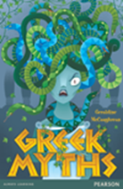
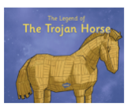


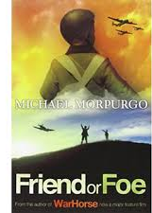


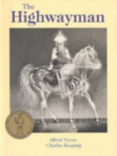

English Progression Map
Year 5
I am familiar with and can talk about a wide range of books and text types, showing understanding and enjoyment.
I can discuss the audience and purpose of the writing.
I can plan my writing, using ideas of my own but drawing on expertise from authors.
People who have changed the World. (Mandela/Shake-speare biography) Firing our imaginations. (Poetry) Exploring emotions. (Diary writing) Stories from the past. (A modern myth) | How can I explain? (An explorer’s handbook) Telling stories through poetry. (My narrative poem) The power of storytelling. (Linked to author visit/WBD) Saving our Planet. (Letter to Blue Peter) | Exploring emotions. (Letter from an evacuee) Painting pictures with words. (Description) We love to read. (Author presentation)
I like recommending books I have enjoyed to others.
I can read non-fiction texts and identify the purpose, structure and grammatical features, evaluating how effective they are.
I can start a sentence in different ways.
I can use the correct features of the text type we are working on and use devices to guide the reader e.g. bullet points.
I can use complex sentences and relative clauses.
I am learning to scan a text in order to help me retrieve key information.
I can write legibly in a joined style, when writing at speed.
I can use correct verb forms, including modal.
I can develop characters through action and dialogue and describe settings and atmospheres effectively.
I can infer characters thoughts, feelings and motives.
Handwriting
I can build cohesion within and between paragraphs.
I can predict what may happen next, from clues or suggestions in the text and can summarise a text using key details.
I can use well chosen vocabulary to create an impact and I can use a thesaurus to help me.
I can use brackets, dashes and commas to indicate parenthesis.
Structure
I can use stylistic devices, e.g. metaphor/simile.
I am beginning to use commas in longer sentences, to clarify meaning or avoid ambiguity.
I can spell the words on our non-negotiable spelling list.
I have strategies for learning new vocabulary, including asking for explanations when I meet an unfamiliar word.
I can proof read my work to check for errors such as inconsistent tense and subject and verb agreement.
I can spell the words from my Year 5 Spelling Shed lists
I can use apostrophes for omission and possession.
I can spell some of the words from the Y5/Y6 spelling list.
I can read my own and others’ work aloud with confidence and can prepare poems to perform, learning elements of them by heart.
I can make changes in order to improve the effectiveness of my writing.
I understand the difference between direct and reported speech.
I can use a dictionary to help spell words correctly in my writing.
Reading
Composition
Punctuation
Spelling

Slide 6


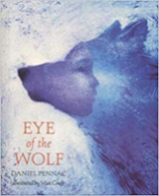
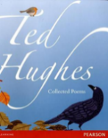
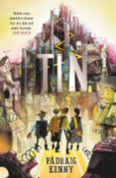
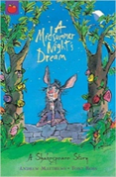
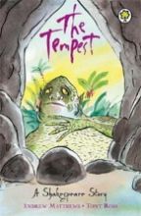
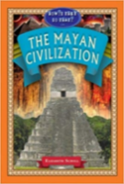



English
Progression Map
Year 6
I am enjoying age appropriate books with confidence and fluency.
I can plan, draft, edit, evaluate and proof read my writing.
Firing our imaginations. (Poetry) Whose point of view? (Writing from different viewpoints) The powers of persuasion. (Letter from Lord Shaftesbury) The power of storytelling. (A Nativity for younger readers | What did you think? (Playscripts and Review of YSC performance) Painting pictures with words. (Description) What’s your opinion? (How to debate) The power of storytelling. (Linked to author visit/WBD) | What do you think is the greatest invention? (Writing an online article) What makes a good reader? (Revision sessions) Preparing to perform! (Scripts for leavers assembly)
I am learning new vocabulary, using appropriate strategies.
I use a range of sentence starters to create specific effects.
I can evaluate how authors use language and consider the impact on the reader.
I use grammatical structures & features and choose vocabulary appropriate to the audience and purpose.
I can vary sentence length for effect.
I can explain and discuss my understanding of what I read, drawing inferences and justifying these with evidence.
I can use a wide range of clause structures and vary their position within the sentence.
I can use adverbs, expanded noun phrases and preposition phrases to add detail to sentences.
I can discuss, debate and give opinions about my reading
I can maintain legibility, fluency and speed in my handwriting.
I can use grammar to create an impact.
I write in paragraphs which can clearly signal a change in subject, time, place or event.
I can predict what might happen from details stated and implied and can summarise main ideas.
Handwriting
I use the correct verb form, including passive and modal verbs.
Structure
I can retrieve, record and present information from non-fiction texts.
I can write cohesively within and across sentences and paragraphs.
I am learning to use the semi-colon, colon, dash and hyphen.
I always spell our non-negotiable words correctly.
I can spell the words from my Year 6 Spelling Shed lists.
I can make comparisons within and across texts.
I can create atmosphere, describe settings and use dialogue to convey character and advance the action in my writing.
I can use the colon to introduce a list and semi-colon within lists.
I can spell most of the words from the Y5/Y6 spelling list.
I can read a variety of texts aloud, including poems, showing understanding through intonation, tone, volume & action.
I can select resources (e.g. a thesaurus) to help with my writing and can use with confidence.
I can use inverted commas, commas for clarity, and punctuation for parenthesis.
My spelling is generally correct and I can use spell checking resources for more ambitious words.
Reading
Composition
Punctuation
Spelling

